Slide 1
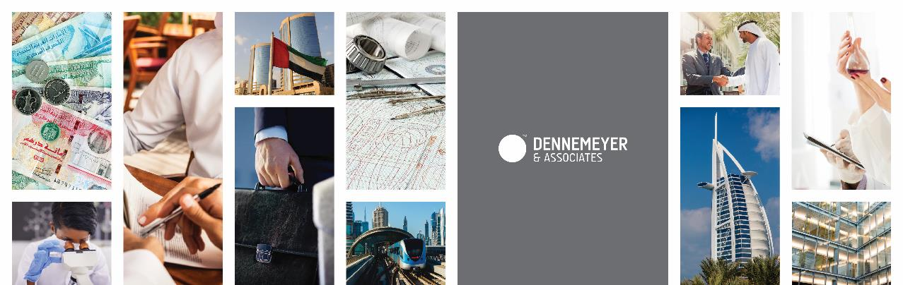
Adriana Butu
Head of Trademark and Recordal Departments
Dennemeyer & Associates, Dubai U.A.E.
abutu@dennemeyer-law.com
Embracing Innovation – GCC Countries' Approach for Economic Sustainability in the Region

Slide 2
Adriana Butu
Head of Trademark and Recordal Departments
Dennemeyer & Associates, Dubai U.A.E.
abutu@dennemeyer-law.com
Embracing Innovation – GCC Countries' Approach for Economic Sustainability in the Region

Slide 3
Dennemeyer – Your global partner with local expertise
We run
We have
We serve
We speak
23
50+
180+
Your language
Offices in
18 countries
Years of experience in intellectual
property
Covered jurisdictions

Slide 4

What is Innovation?
is…
“a great idea, executed brilliantly and communicated in a way that is both intuitive and fully celebrates the magic of the initial concept.” (Pete Foley)
“the implementation of creative ideas in order to generate value, usually through increased revenues and reduced costs” (Jeffrey Baumgartner)
“is the key to our progress” (Sheikh Mohammed bin Rashid Al Maktoum)

Slide 5
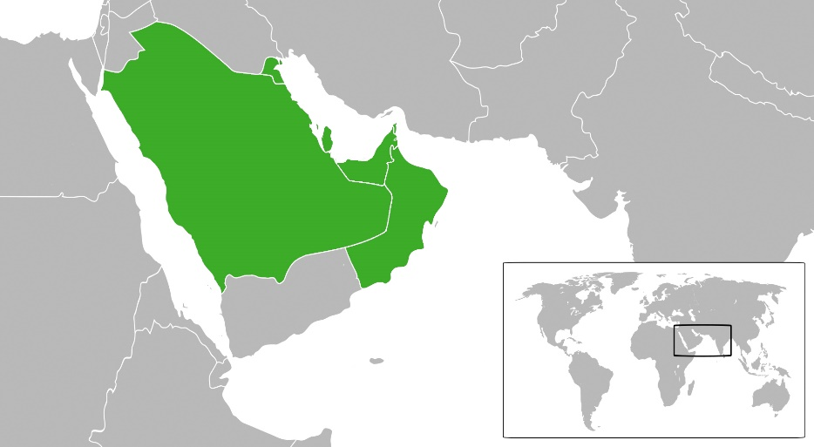
The GCC Countries
The Gulf Cooperation Council (GCC) is a regional political organization, formed by 6 countries:
Bahrain
Kuwait
Qatar
Oman
Saudi Arabia
The United Arab Emirates
All the 6 countries are well known for their oil & gas based economies, resources which transformed the entire region due to its fulminant development.

Slide 6
Diversified Economy - The Impact On The IP Regulations
Two of the objectives of the GC Council:
foster innovation in different fields
have similar regulations in different fields in the member countries
Two important steps taken in order to protect the innovative ideas:
implementation of the GCC Patent Office
Implementation of the GCC Trademark Law

Slide 7
The GCC Patent Office – Quick Facts
Established in September, 1992 in Abu Dhabi, U.A.E.
Started to receive applications in October, 1998
Located in Riyadh, Saudi Arabia and has no other branches
Receives only patent applications
One GGC Patent granted is valid in all the GCC member states
In addition to the TRIPS requirements for an invention to be patentable [novelty, industrial applicability, non-obviousness (inventive step)] a GCC Patent application should also respect the Sharia Law regulations

Slide 8
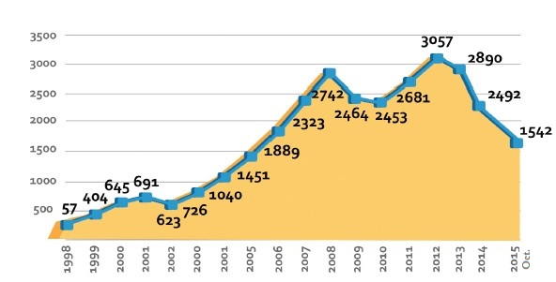
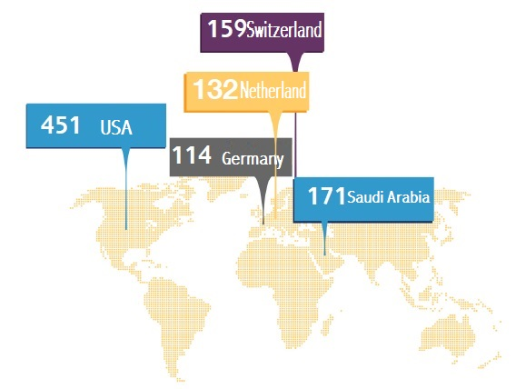
The GCC Patent Office - Statistics
Applications filed annually
Patents granted annually
Top 5 filing countries
Applications filed annually

Slide 9
The GCC Trademark Law– Quick Facts
Scheduled for enactment in 2006, put on hold, amended and approved in December 2012
Its goal is to create uniformity in the current trademark laws of the GCC countries
Does not provide an unified filing system
Currently approved in: Bahrain, Kuwait, Qatar and Saudi Arabia
The member countries have the freedom to apply in part the regulations stipulated by the GCC TM Law

Slide 10

Innovation Sector in the GCC Countries
Saudi Arabia
The Kingdom ranked 3rd in the innovation index in
2015, with 763 inventions and 869 industrial designs.
Its biggest scientific organization, responsible for promoting science and technology, King Abdulaziz City for Science and Technology (KACST) was founded 1977.
The research complex is divided into 7 research institutes: Atomic Energy Research Institute, Computer and Electronics Research Institute, Petroleum and Petrochemical Institute, Energy Research Institute, Resource and Development Institute, Astronomy and Geophysics Institute and the Space Research Institute.

Slide 11
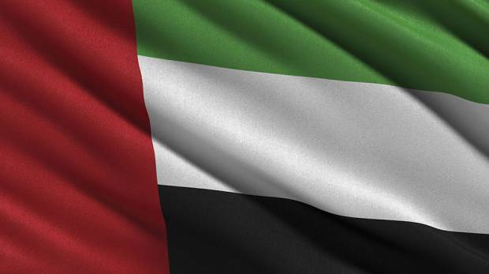
Innovation Sector in the GCC Countries
United Arab Emirates
In October 2014 the Vice-President and Prime Minister
of the UAE and Ruler of Dubai, launched a National
Innovation Strategy with the aim of making the UAE
one of the most innovative nations in the world within
seven years.
The strategy will stimulate innovation in seven sectors where innovation is the key to excellence: renewable energy, transport, education, health, technology, water and space.
Its first phase includes 30 national initiatives to be completed within three years. These include new legislation, innovation incubators, investment in specialised skills, private sector incentives, international research partnerships and an innovation drive within government.

Slide 12




Innovation Hubs in the United Arab Emirates
, Abu Dhabi – focused in advancing the development, commercialisation and deployment of renewable energy and clean technologies as a link between today’s fossil fuel economy and the energy economy of the future;
, Dubai – MENA’s largest ICT hub, fosters entrepreneurs, empowers SMEs, and attracts global ICT leaders to Dubai;
(In5), Dubai – offers state-of the art and specialized facilities catering to Technology, Media and Design industries as well as facilitates training and mentorship programs;
, Dubai - focused in helping entrepreneurs start a business in any sector with strategy, establishment and tangible growth.

Slide 13

Innovation Sector in the GCC Countries
Qatar
Qatar’s national vision of transitioning towards
a knowledge-based economy is rooted in
developing the state as a regional and
increasingly global leader in research and development.
The firsts step in this direction: Qatar Foundation established in 1995 in Doha.
The activities of the organization are orientated towards: education, science and research, and community development.
Today Qatar Foundation counts more than 40 entities, from schools and universities to health, technology and art centers.

Slide 14

Innovation Sector in the GCC Countries
Oman
In its Vision 2020 the government has given
priority to innovation, setting strategic plans
that contribute to building and spreading this concept in the Omani community.
The Innovation Park Muscat is a great progress in this regard, being designed to supporting the growth of Oman-based innovative and research-driven companies in the fields of oil recovery, renewable energy, food and biotechnology, water, environment and health science.

Slide 15

Innovation Sector in the GCC Countries
Bahrain
The smallest country from the GCC region
has made significant steps towards
attracting foreign investments and facilitating
entrepreneurship through innovative
governmental reforms in different fields.
The Bahrain Science and Technology Park is set to provide researchers with the entire set-up in their activity.
The Bahrain International Investment Park is currently providing business opportunities for those interested to locate manufacturing and international services operations in the Middle East, offering a tax free location with full duty free access to GCC markets.

Slide 16
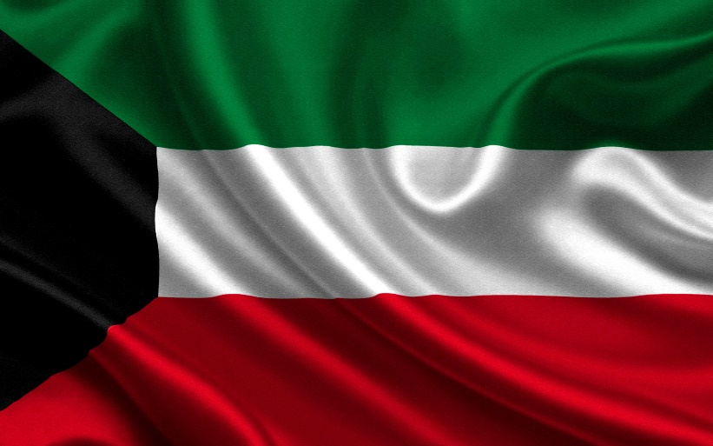
Innovation Sector in the GCC Countries
Kuwait
It is one of the richest countries in the world,
per capita, but also the Gulf country with the
lowest amount of foreign investment and
economy diversification.
The investments in the Kuwaiti Foundation for the Advancement of the Sciences and the implementation of the Kuwaiti National Fund for Small and Medium Enterprise Development in 2013 – a national venture fund with access to $7 billion dedicated to support local Kuwaiti entrepreneurs - could boost private enterprise creation and research commercialization by Kuwaiti scientists and university researchers.

Slide 17
Changes required?
In order to be innovative, the following conditions must be considered:
access to finance
skills for innovation
developed IP system
competition and standards
policy framework

Slide 18
Regional Impact
Economic growth and employment
Scientific and Social progress
Better quality of products and services
Increased customer satisfaction
Diversity
Business agility
Environmental benefits

Slide 19
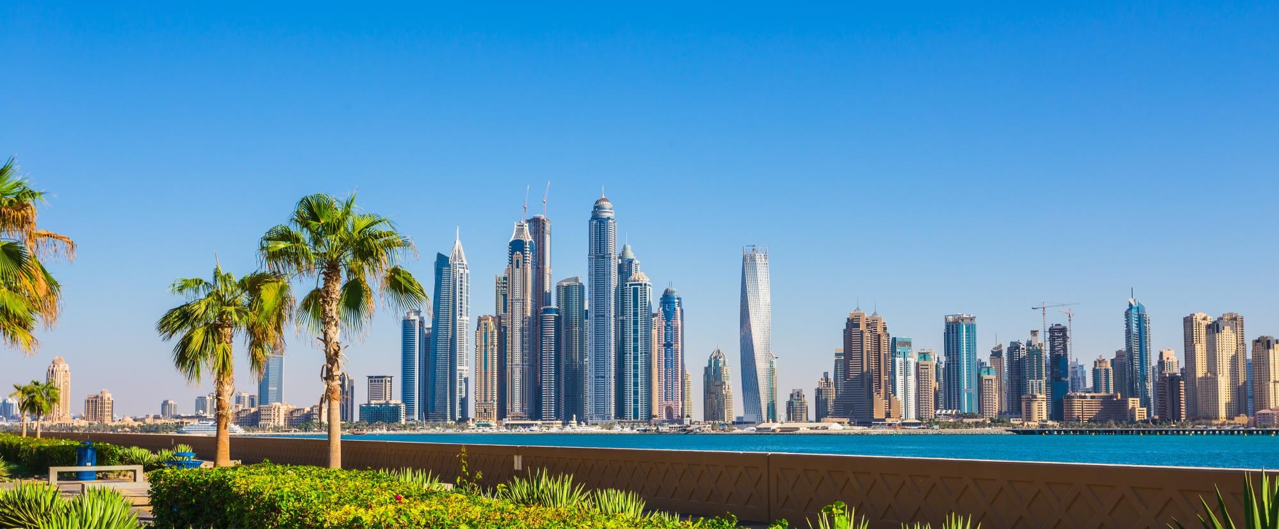
Thank you!

